Slide 1
15- Tuples

Slide 2
context
What is a tuple? 3
defining variable with one item in a tuple 4
concatenate two tuples 5
Repeat a tuple 6
tuple(<iterable>) : tuple | built in function 7
Ex.1 8
access individual items 9
tupleObject[index]
tupleObject[index:index]
Unpack 10
anObject in tupleObject | in operator 11
Ex.2 12

Slide 3

What is a tuple?
A topple is basically a read only list
We can not
Add
Remove
Modify

Slide 4



one tuple item
you should add a trailing comma, Otherwise python thinks you're defining an integer.

Slide 5

concatenate two tuples

Slide 6

Repeat a tuple

Slide 7
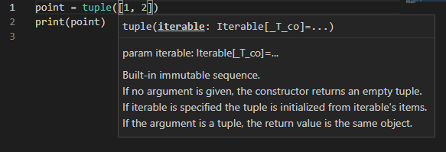
tuple(<iterable>) : tuple | built in function

Slide 8

Ex.1

Slide 9


access individual items tupleObject[index] tupleObject[index:index]

Slide 10

unpack

Slide 11
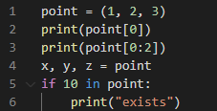
anObject in tupleObject | in operator
the in operator to check for the existence of an item

Slide 12
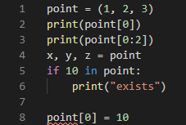
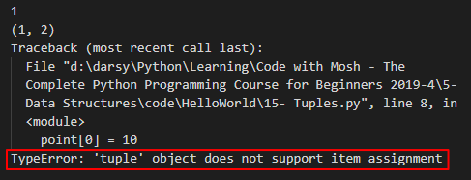
Ex.2

